Slide 1

Increasing employee retention
Presented by:
Skyler Harmon

Slide 2


Presentation Overview
Goals for Presentation
Increase employee retention
Analyze key indicators that predict employee retention
Make recommendations based on relevant indicators
Dataset for Analysis
Source: Kaggle
This dataset reviews 10 keys indicators (11 columns) for 14,999 employees (records).

Slide 3
Dataset Features
Variable | Quantitative/Qualitative | Variable Type
Satisfaction Level | Quantitative | Discrete
Last Evaluation | Quantitative | Discrete
Number of Projects | Quantitative | Continuous
Average Monthly Hours | Quantitative | Continuous
Time Spend Company | Quantitative | Continuous
Work Accident | Qualitative | Binary
Left | Qualitative | Binary
Promotion Last Five Years | Qualitative | Binary
Department | Qualitative | Nominal
Salary | Qualitative | Ordinal
Variables Used for Analysis:
Satisfaction Level
Left
Promotion Last Five Years
Salary

Slide 4
Hypotheses
Promotions
Salary
Ho: There will not be a significant difference in satisfaction levels for employees who received a promotion in the last five years and those who did not.
Ha: There will be a significant difference in satisfaction levels for employees who received a promotion in the last five years and those who did not.
Ho: There will not be a significant difference in satisfaction levels for employees with medium to high salaries and those with low salaries.
Ha: There will be a significant difference in satisfaction levels for employees with medium to high salaries and those with low salaries.

Slide 5

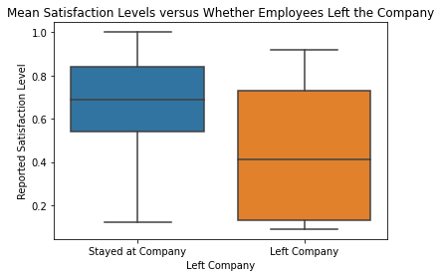
Employee Satisfaction as an Indicator for Employee Retention
Hypothesis
Ho: There will not be a significant difference in satisfaction levels for employees who stayed at their company and those who left.
Ha: There will be a significant difference in satisfaction levels for employees who stayed at their company and those who left.

Slide 6
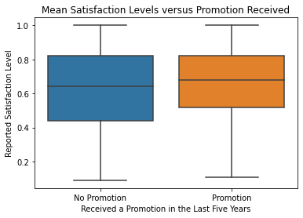
Hypothesis 1: Promotions
Methods:
-A two-sample t-test was run to compare the mean difference of reported employee satisfaction between employees who received a promotion in the last five years and those who did not.
-The two groups were established using the .iloc function in Python.
Results:
-Null hypothesis rejected.

Slide 7
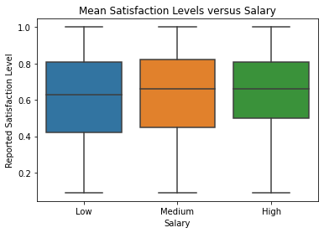
Hypothesis 2: Salary
Methods:
-A two-sample t-test was run to compare the mean difference of reported employee satisfaction between employees with a medium to high salary and those with a low salary.
-The two groups were established using the .loc function in Python.
Results:
Null hypothesis rejected.

Slide 8



Final Recommendations
Reported employee satisfaction has a significant impact on whether employees will stay at their company or leave their company. The following recommendations will show higher levels of employee satisfaction in the workplace:
Increasing opportunities for promotions in the workplace.
2. Increasing employees' salaries.

Slide 9

Next Steps:
Analyzing recommendations from a company’s perspective:
1. Productivity vs. job satisfaction
2. KPIs with internal promotions vs. external
3. Comparing company’s profit with increased salaries vs. without

Slide 10


THANK YOU
Source Material:
-Original Data Source
-Project Proposal
-Colab Notebook

